Slide 1

WEB TECHNOLOGIES
SUBMITTED BY:
211FA04562
211FA04573
211FA04588
211FA04609

Slide 2
WHAT TO EXPECT AHEAD:
INTRODUCTION
WHAT IS EXPRESS JS
NEED OF EXPRESS JS
FEATURES OF EXPRESS JS
ADVANTAGES AND DISADVANTAGES
COMPANIES USING EXPRESS JS
CONCLUSION

Slide 3
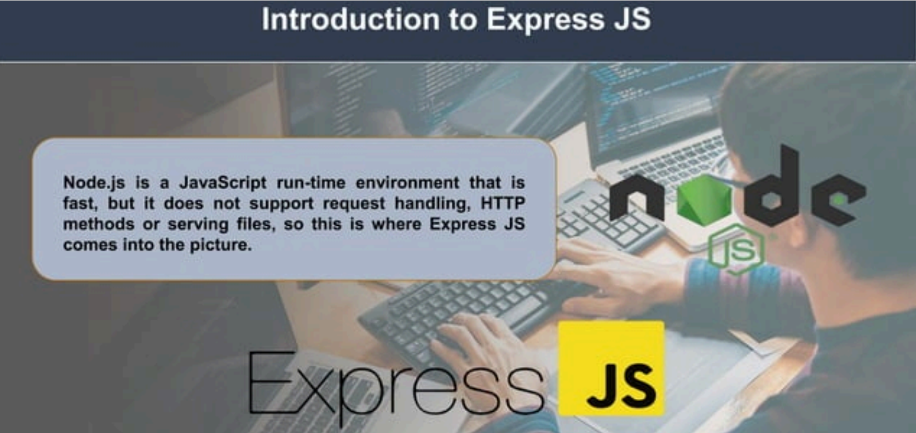
INTRODUCTION

Slide 4
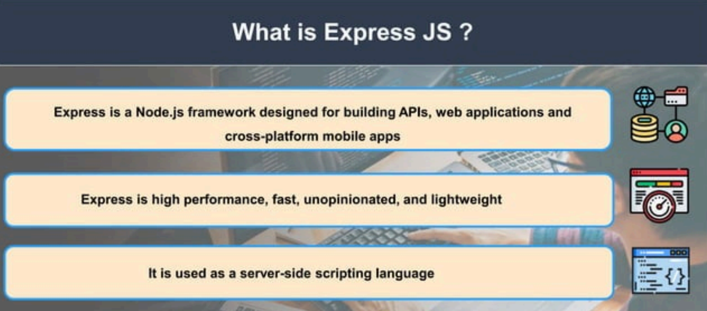

Slide 5

NEED OF EXPRESS JS
Express was created to make APIs and web applications with ease,
It saves a lot of coding time almost by half and still makes web and.
mobile applications are efficient.
Another reason for using express is that it is written in javascript as JavaScript is an easy language even if you don't have a previous.

Slide 6

EASY TO LEARN
ASYNCHRONOUS

Slide 7
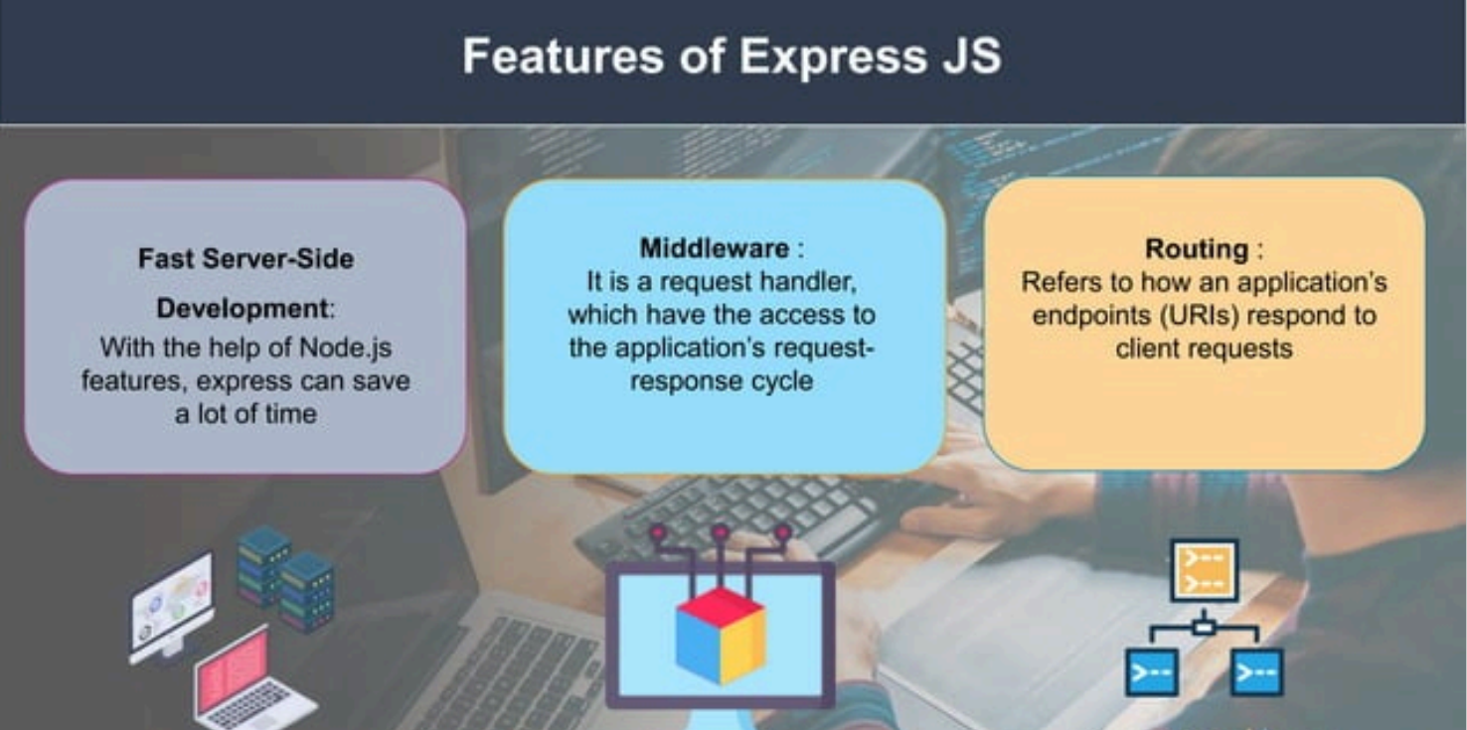

Slide 8
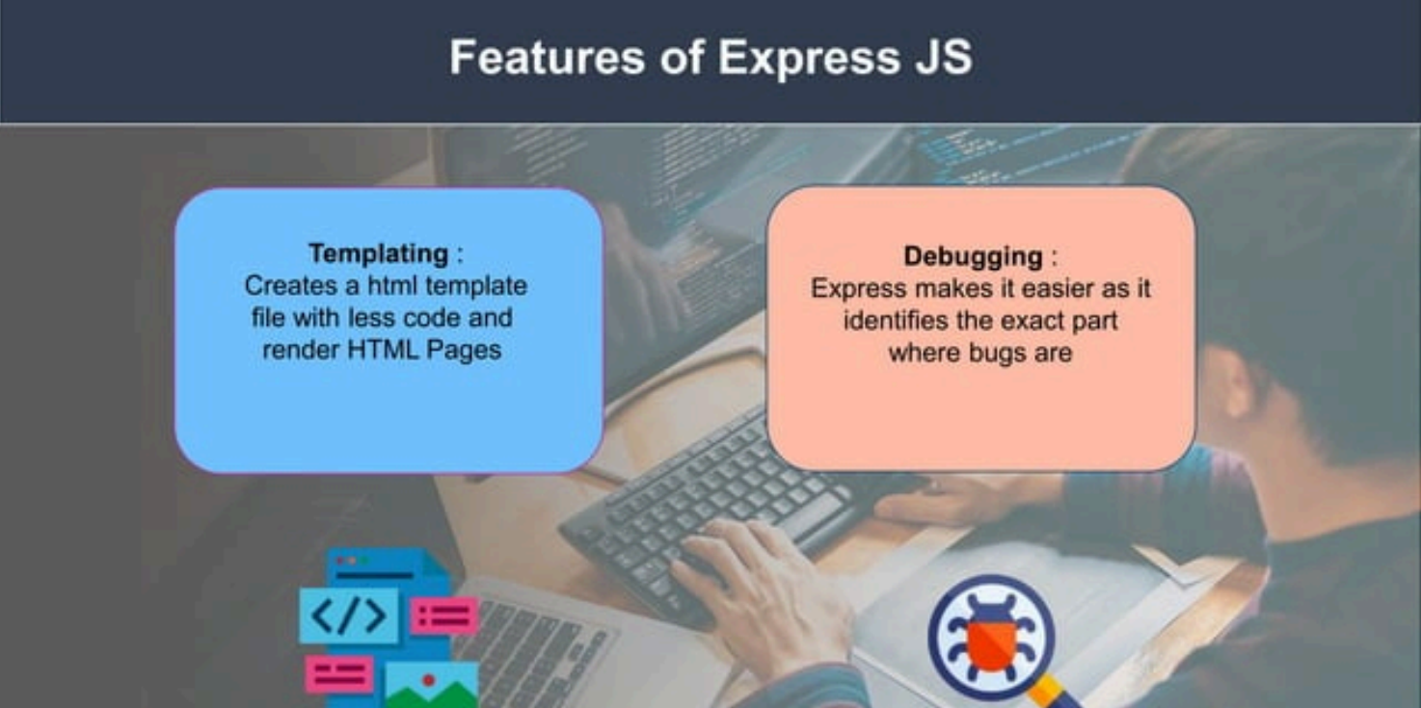

Slide 9
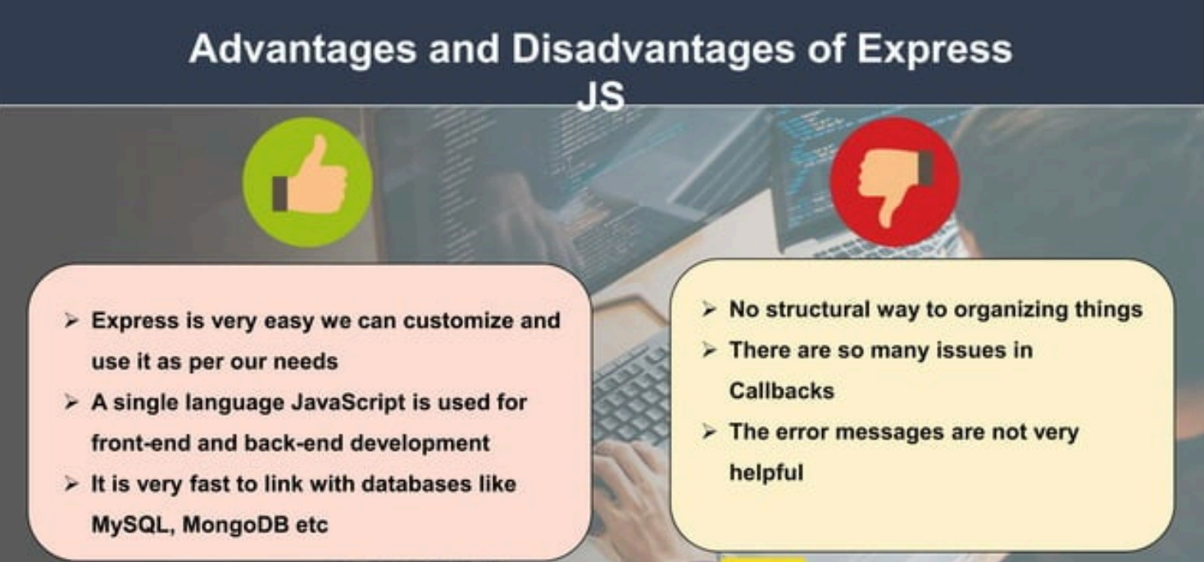

Slide 10
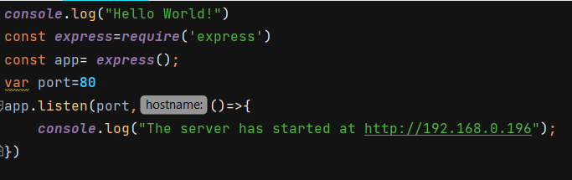
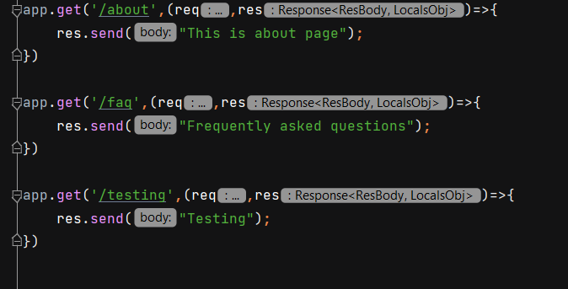
Implementation:
Define route for pages:

Slide 11
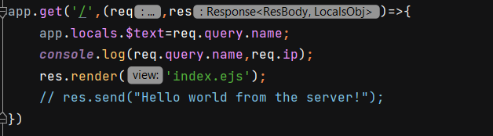
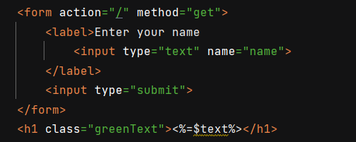
Defining root route:
Access global variables in Express JS:

Slide 12
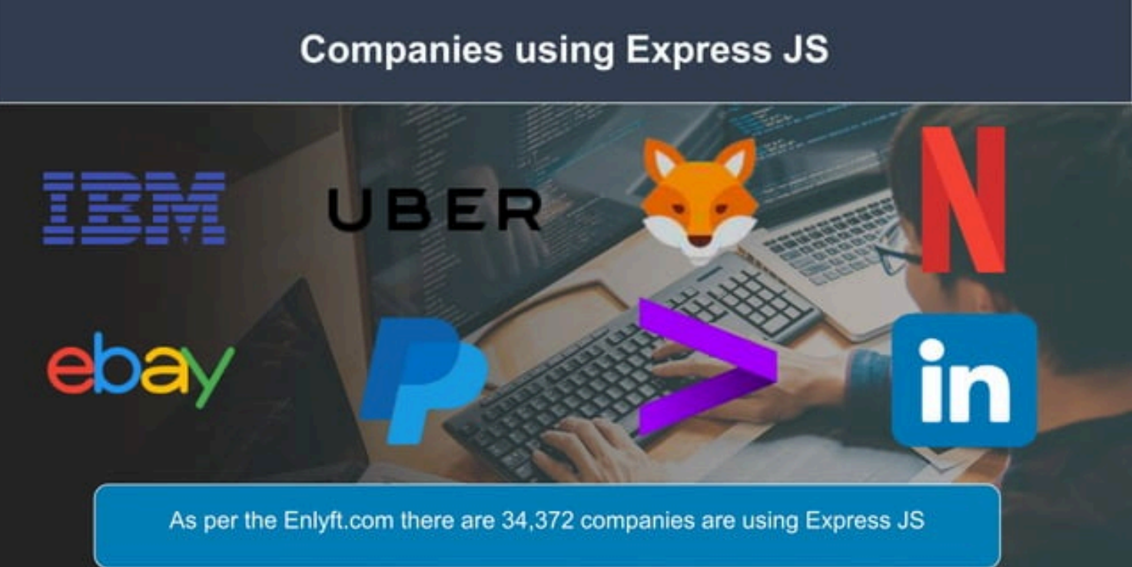

Slide 13
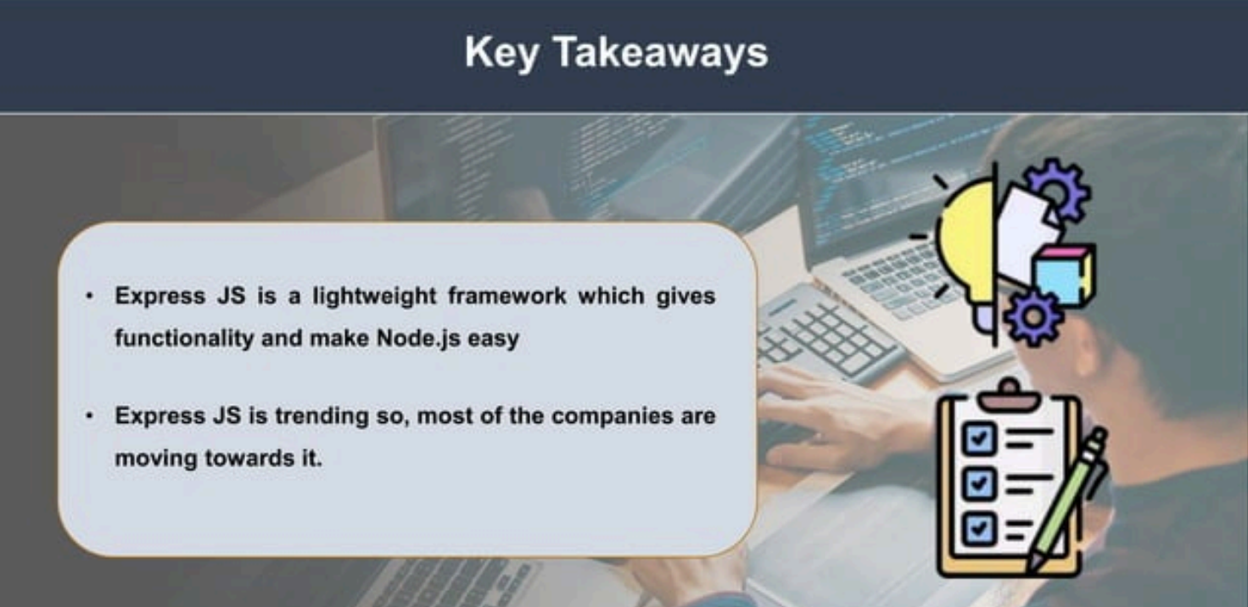

Slide 14

CONCLUSION
Express.js is a powerful and popular web application framework for Node.js that has become a cornerstone in the development of web applications and APIs. Its simplicity, flexibility, and minimalist design have contributed to its widespread adoption within the Node.js ecosystem

Slide 15

Thank you

